Slide 1


Dance Music Genre Classification with Convolutional Neural Networks
Amy Taylor,
DSI-6, 2/13/19

Slide 2

Introduction
Why Dance Music?

Slide 3
About Me
Techno and electronic music enthusiast
Has a love/hate relationship to how we define/classify artists into genres
Genres = helpful, but sometimes too restrictive, and always evolving
Convolutional Neural Networks(CNN)
Commonly used for music genre classification (broad genres)
Can we create CNN for classifying techno genres? (closely related genres)
My Motivations
Distinguish between types of dance music I DO like (techno) and dance music I DON’T like (“EDM”)
Distinguish between different genres of techno
Learn about the field of Music Information Retrieval (MIR)

Slide 4
This Project - Two Parts
Part 1: Techno vs. “EDM”
Part 2: Sub genres of techno
Train a network to distinguish between two distinct sounds of dance music
Train a similar network to distinguish between 5 popular techno record lables
Label = music distribution brand/company
Each label “represents” a different sub genre
Why only five genres? Limitations on network size and computational time
Part 1: entire process explained (data collection, modeling, results)
Part 2: just show model and results
Notes:
More straight forward, and consisted of training a network for binary classification between techno songs and EDM songs. I started with this because I wanted to see how the network would perform with two styles of dance music that are different enough that I can distinguish them,
Then in Part 2I used the framework of this model and extended it to a multiclassification problem, specifically to see if the model could distinguish between different, but closely related genres of technos. Genres were picked by choosing 5 popular but distinct record labels, which are the companies that distribute artists tracks. In the world of electronic music, music labels typically select tracks that embody a particular sound or aschetic, and spin-off labels are frequently created to give a home to emerging or niche styles. Labels can be a much more informative descriptor than genres at times.
I only did 5 genres because I originally did more, then experienced some issues with file size in the cloud along with computational time issues.
For this presentation, I will walk through the entire process of data collection, modeling, and results for just Part 1, or the Binary classification, then I will describe the model results for Part 2 with multiclassification

Slide 5

Background:
A brief history of techno and “EDM”

Slide 6


Origins
Detroit, late 1980s
House, disco, new wave, progressive influences
Embodied Detroit’s “post-industrial condition”
Similar movement takes off in Berlin → better infrastructure for underground scenes to flourish
Greater commercial success in Europe - now unofficial home
Techno = subgenre AND umbrella term for many genres
Techno
“EDM”
EDM (actual meaning) Electronic dance music. An umbrella term for the MANY subgenres of dance music made from computers
“EDM” (common usage)
Refers to most recognized, commercial style of American dance music (typically progressive house) characterized by artists such as Tiesto, Avicii, David Guetta, Diplo, Calvin Harris
You discover “EDM” because it’s popular.. the more you grow into the scene the more you discover sub-genres like techno and house.

Slide 7
Characterized by
Sounds
Culture
- 4/4 tempo, Beat focused
- Without vocals
- Industrial, futuristic
- Rhythmic, hypnotic, repetitive
- Mood: Distopian (hope/fear/angst)
- Made for mixes, dancing
- Venues = underground, secret parties, small clubs
- Dancefloor centric experience
Techno
“EDM”
- Build-up and “drop” focused
- With verses, (female vocals)
- Energetic
- Basslines - drive tension
- Emotive synth melodies
- Trance, dubstep, pop elements
- Mood: Happy, party, hedonism
- Made for radio, nightclubs
- Venues = Festivals
- DJ-centric performance
- Younger audience

Slide 8

Dataset
Songs and Audio features acquired from Spotify API

Slide 9




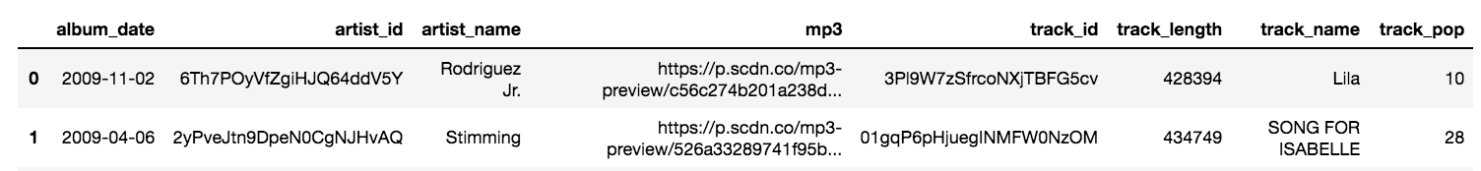
Select Public Playlists from Spotify. Download tracks
Two playlists randomly chosen (google search)
Spotify API endpoint = GET a Playlist’s Tracks
Wrapper used = Spotipy library
Acquired:
track_id,
mp3 link
Final Number of tracks (with mp3)
Techno = 866 tracks
EDM = 929 tracks
30 second clip

Slide 10
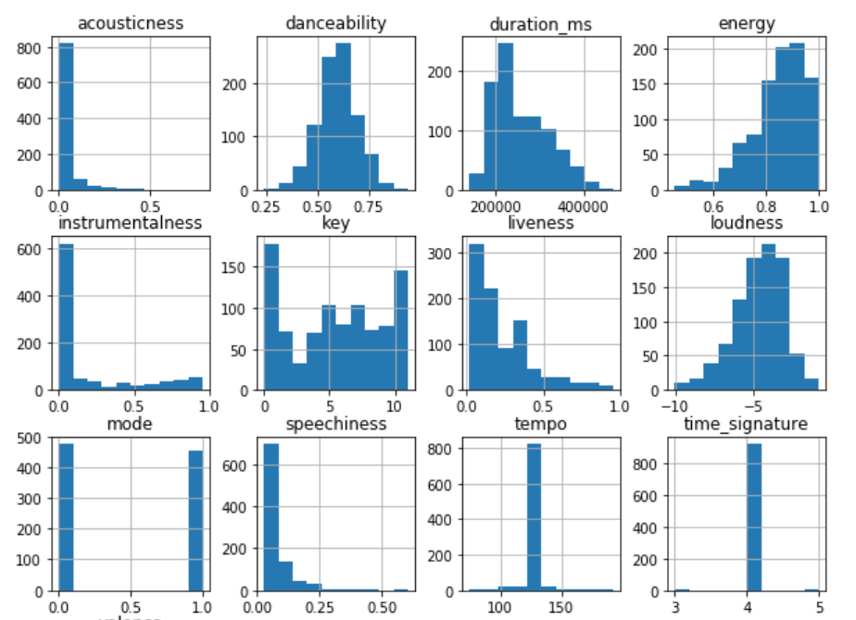
2. Use Track IDs to Download Audio Features; EDA
Spotify API endpoint = GET Audio Features for Several Tracks
Audio Features Available:
Acousticness Loudness
Danceability Mode
Energy Speechiness
Instrumentalness Tempo
Key Time Signature
Liveness Valence
 | Techno | EDM
Tempo (bpm) | 124 | 127
Instrumental | Predicts NO vocals | Predicts vocals

Slide 11

Audio Manipulation
Librosa library: mp3 → Waveform → Spectrogram

Slide 12
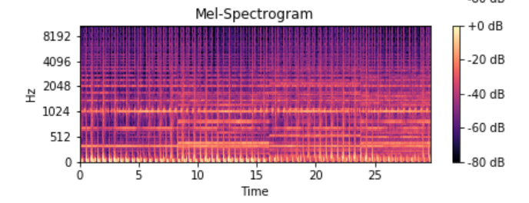
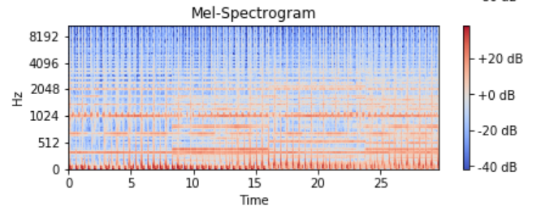
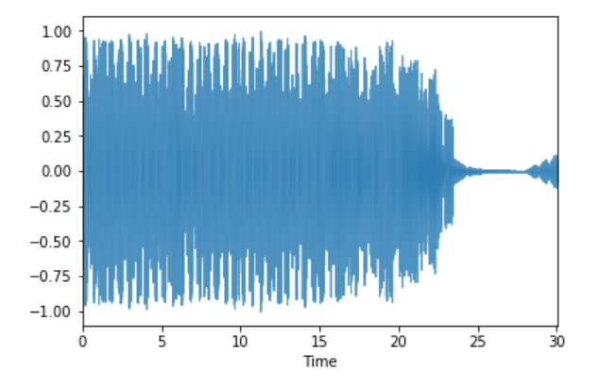
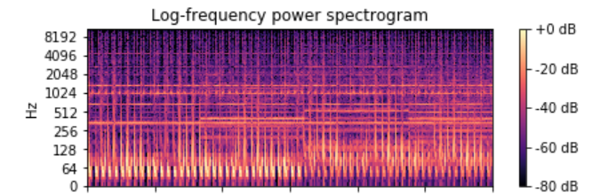
Librosa Applications
Load mp3 file into librosa = get waveform
2. Convert to spectrogram (or mel-spec)
Waveform =
Time vs Air pressure
-1D array, time series
- Spectrogram = distributions of energy over a set of frequencies (involves a Fourier Transform)
- 2D array: Time vs. Frequency distribution bins
- Mel-spec = Hz scaled similar to human frequency perception
- good for = timbral aspects (instrumental differences)
- not good for = pitch classes
NOTE: Many unique spectral conversions available!
Data can be visualized in a variety of time or frequency unit → these change how the spectrogram looks, and the image fed into our model
(Ie. log spaced Hz = better for pitch based analysis )
Notes:
1. Running the function librosa.load decodes the mp3 audio signal as time series, or one dimensional numpy array. This waveform is a pressure-time plot and graphically represents the change in air pressure at a certain time.
2. Next, the waveform is converted to a spectrogram by performing a fourier transform, so the

Slide 13
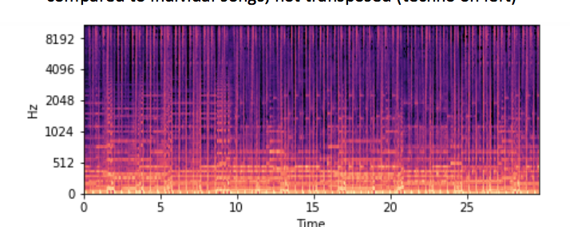
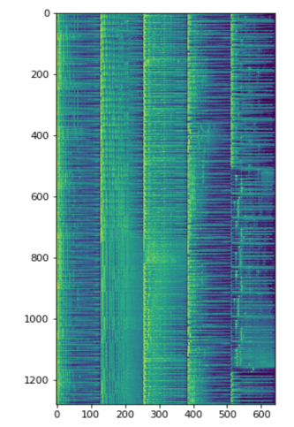
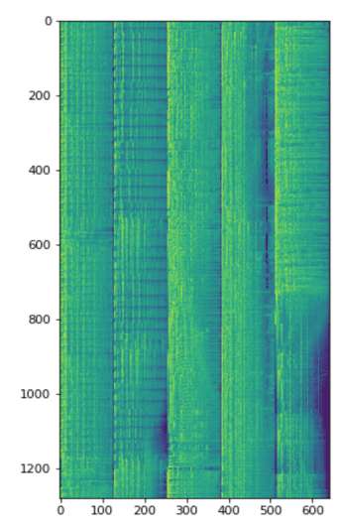
Visually Comparing Techno vs. EDM
1 track
x-axis = Time (30 s)
y-axis = Hz (128 bins)
5 tracks (pasted together)
x-axis = Hz (128 bins)
Y-axis = Time (1280 frames)
Comparing the first 5 songs of each dataset:
They look different enough to me!
And probably a neural network too!
Techno
EDM

Slide 14

CNN Model Design
Part 1: Techno vs EDM , Binary Classification

Slide 15
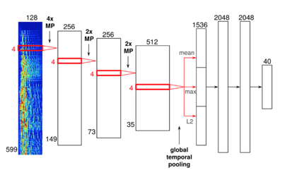
Split 1 track into 10
→ increase sample size
Sample input = 128 x 128 frame
- Input = 128 x 128
- 3x CNN layers:
Conv1D
Batch Normalization
Max Pool
Dropout (in 1,2 layer)
-Global Max Pooling
-Dense, Dropout
-Dense
Output = 2
1-dimensional convolution
on Time axis

Slide 16
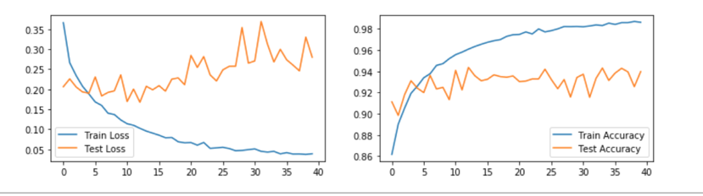
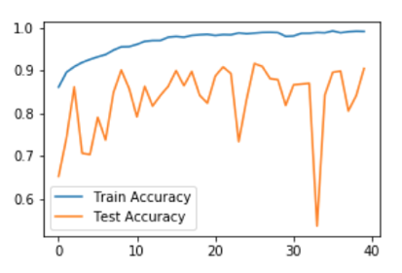
Results
Loss
Train = 0.04%
Test = 0.28%
Accuracy
Train = 98.6%
Test = 94%
Biggest Factors
Direction of convolution
Time on y axis (vs on x-axis)
Frequency scale = normalized
Batch Normalization
Dropout amount
Better in some layers
Less Important
Kernel size, number of filters
Third CNN layer

Slide 17
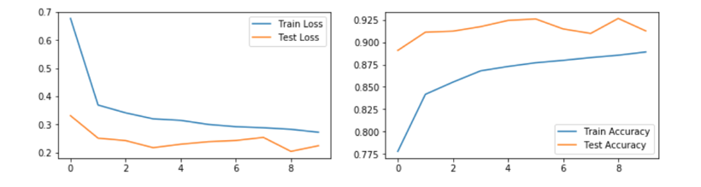
Similar Results with 2D CNN model
Loss
Train = 0.27%
Test = 0.22%
Accuracy
Train = 89%
Test = 92%
Less overfit, smoother
Test scores better than training set

Slide 18
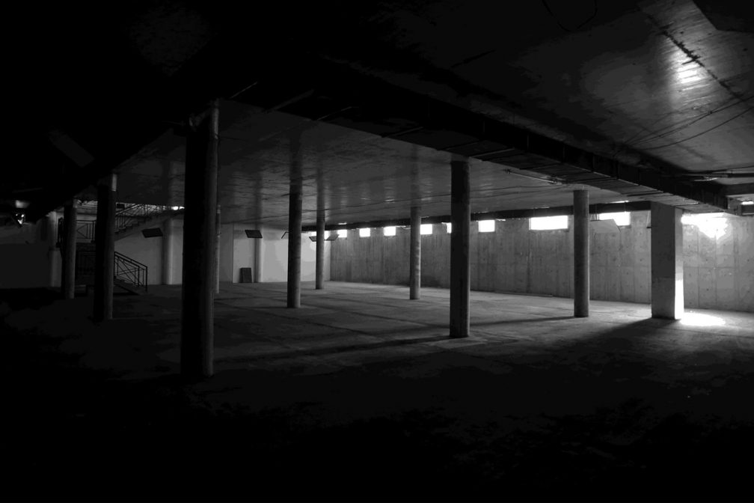
CNN Model Design
Part 2: Multiclassification of different techno genres
5 music labels (genres)
Drumcode = festival techno, driving, filter sweeps
Ostgut ton = hard-edge techno, minimal, heady
Lobster Theramin = lofi, emotive, acid, rolling textures
Kompakt = minimal, ambient
Dirtybird = deep house / tech house
Baseline accuracy = 29%

Slide 19
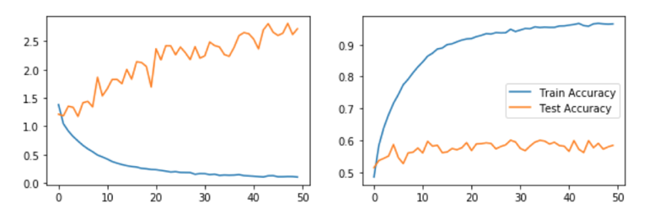
Results with 1D CNN model
Loss
Train = 0.10%
Test = 2.71%
Accuracy
Train = 96%
Test = 58%
2D results is similar

Slide 20

Final Thoughts

Slide 21
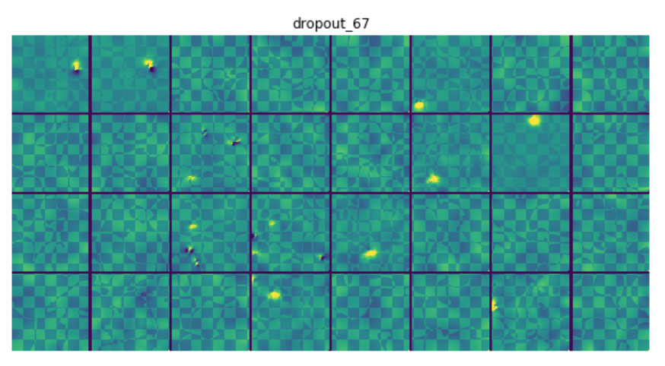
With Additional Time I would:
Get AWS connection working for faster GPU computation
Parameters not explored: regularization value, batch size
Explore other network designs - RNNs, LSTMs
Explore different spectrogram formats (i.e. harmonic, percussive, pitch elements)
More analysis of the filter images produced - not enough time to discuss here
Example of filters from 2D CNN

Slide 22
Photo Credit References
https://www.residentadvisor.net/images/events/flyer/2017/10/de-1003-1010308-1012704-back.jpg
https://mixmag.net/read/16-mega-industrial-venues-perfect-for-your-techno-exercise-galleries/
https://www.theclubmap.com/2019/01/25/26-1-2019-tresor-meets-bosconi-records-10-yrs/
https://www.youtube.com/watch?v=mRxVTtNc2hM
https://www.skiddle.com/whats-on/Liverpool/24-Kitchen-Street/Melos-Presents-Wake-Deeper--Late-Night-Techno-Party/13165019/

Slide 23
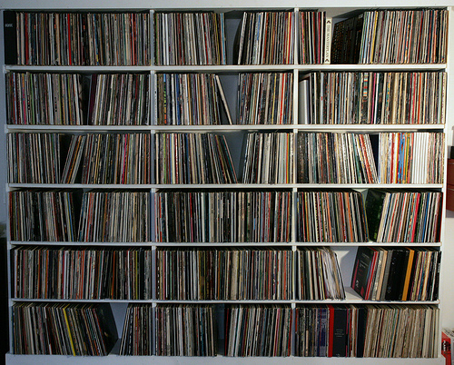
Thank You!

Slide 24
Visually Comparing Techno vs. EDM
1 track
x-axis = Time (30 s)
y-axis = Hz (128 bins)
5 tracks (pasted together)
x-axis = Hz (128 bins)
Y-axis = Time (1280 frames)
They look different enough to me!
And probably a neural network too!
Techno
EDM

